Slide 1
SPM FINAL PRESENTATION
G6T6
54.86.180.118
Zheng Yang
Maurice
Sebastian
SuJuan
ZiCan

Slide 2
TABLE OF CONTENTS
SCHEDULE
01
03
USE OF GIT
02
04
BUG METRIC
OTHERS
Notes:
schedule is the difference between the planned and actual
bug metric sharing about how we use the bug metric to help us record the bugs and the challenge we face
we will go through our team use of git the data of our commit log project timeline as well
then we will share some interesting fact and key takeaways from our members and some conflict we face

Slide 3
SCHEDULE
PLANNED
ACTUAL
MILESTONES
Login, Bootstrap, R1 Bid, Drop Bid
R1 Clear, Drop Section, AWS Deployment
Round Controls, R2 Bid, R2 Clear, JSON Token, JSON Rounds
All other JSON APIs
3 Extra functionalities, Final Debugging
Final
Presentation
Drop Bid,
Iter1 Func. Test
bid-status JSON
Dropped 1 Extra Functionality
Login, Bootstrap, R1 Bid
R1 Clear, Drop Section, AWS Deployment
Round Controls, R2 Bid, R2 Clear, JSON Token, JSON Rounds
All other JSON APIs
2 Extra functionalities, Final Debugging
Final
Presentation
PM Review (Sujuan)
Online Demo (ZIcan)
UAT (Maurice)
Final Submission (Sebastian)
Final Presentation (Zheng Yang)
*Iteration 2 to 5 also includes regression testing.
Notes:
at the start the plan is not so perfect we face some time issues
But we didn’t extend the literation time so we had to move the drop bid function and iteration testing to the subsequent iteration
we got a new requirement of bid-status json so we added the new function in iteration 5 and we delete the extra function of bid-status because we did record the status from the previous bidding round so we don’t feel it will be quite useful to add this extra function .

Slide 4
FUNCTIONALITIES
NO DROPPED FUNCTIONALITIES
CLASS & EXAM TIMETABLE
COURSE SEARCH BAR
NO FRAMEWORKS USED
Notes:
we didn’t drop any required functionalities and we add two extra functions one is class&exam timetable because we were inspired by boss which has a similar and useful functionality and another is course search bar which is based on the feedback we received from another from during the manual UAT which felt that searching for course bidding details in round 2 was not intuitive on our old UI, which help us to do the course filter. we don’t use any frameworks. we try to use before but we found that the whole team is not confident using the framework then we decide to not use.

Slide 5
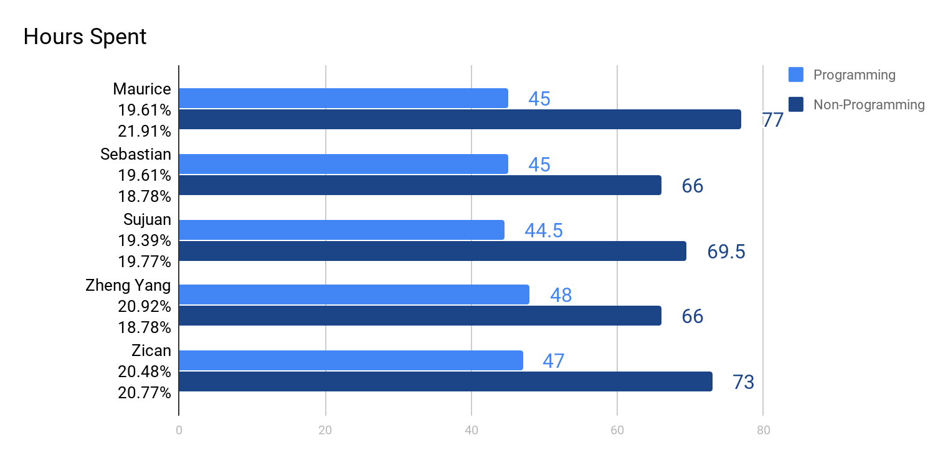
BREAKDOWN OF WORK

Slide 6
SCHEDULE TRACKING
Problems | Solutions
If a pair decides after 12pm they have spare time to work, it won’t be updated in DU. | PM monitors Github commit history, members update PM if they decide to do something after DU 12pm update.
New project requirements on wiki or learning points from elearn discussion forum affects schedule tracking. | PM updates task into schedule based on urgency and redoes schedule tracking.
Functionality is not completed within a single pair programming session and put on hold. | PM takes note of the task put on hold and spends extra effort communicating with the pair to keep within track schedule.

Slide 7
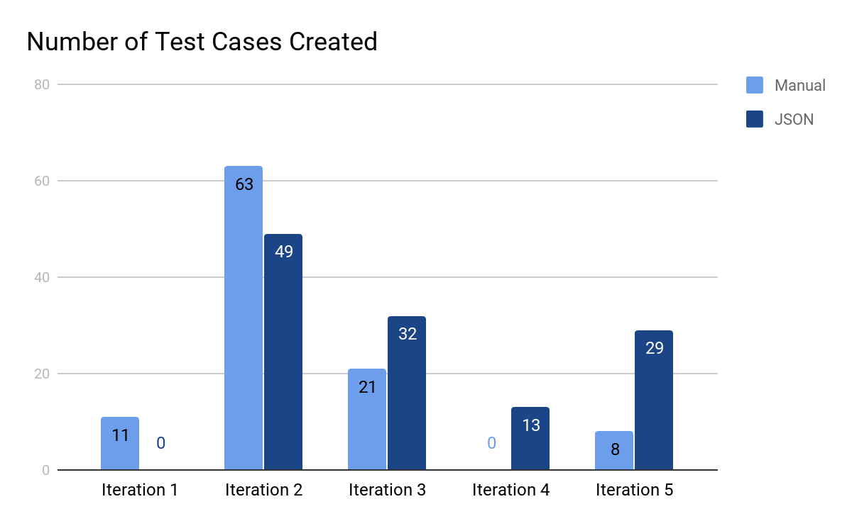
TEST CASES SUMMARY

Slide 8
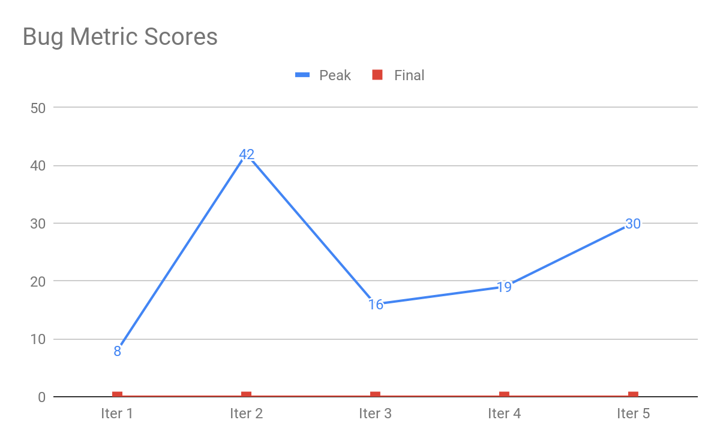
BUG METRICS SUMMARY

Slide 9
SEVERE PROBLEMS & OUR ACTIONS
Problems | Solutions
GitHub repo file names are not case sensitive but AWS is | Uploaded to GitHub copy of app with correct casings, PM ensured that all members updated their local repo with the correct casing
Difference in sorting order for JSON functions a couple of days before UAT date | Pair programming team put their current tasks on hold and worked as a team to debug and modify relevant functions
We only realised that edollar was not stored as float properly in the database a day before UAT | PM organised an urgent meeting with available members to debug

Slide 10
CHALLENGES FACED WHEN USING BM
Problems | Solutions
Subjective rating of bug severity | Discussion of bug severity standards as a group at weekly scrum meetings
Bug description in earlier iterations does not accurately point out location of error | PM to include description of bug and detailed procedures of reproducing the bug

Slide 11
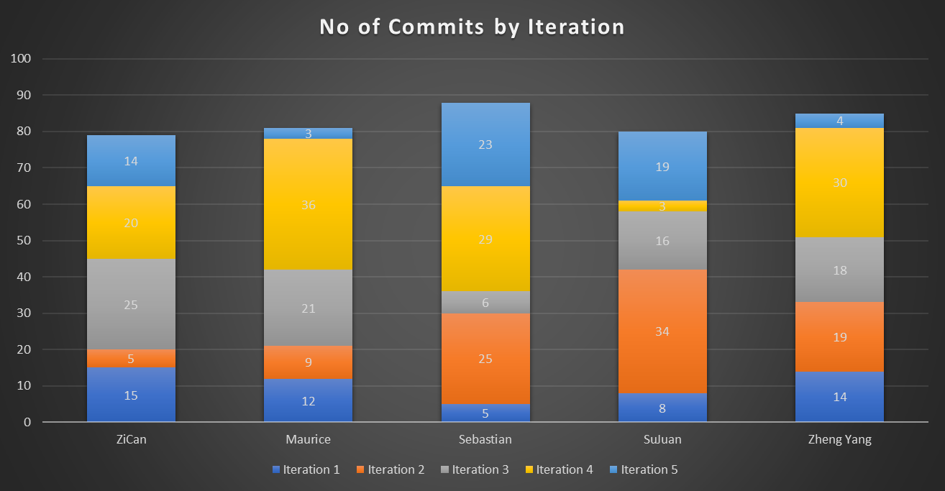
USE OF GIT

Slide 12



KEY TAKEAWAYS
Start Early and Overestimate Planned TIme
Importance of proper documentation
Conflict Management

Slide 13



CONFLICTS
Documentation
Coding Standards
Lack of communication when modifying function

Slide 14
INTERESTING FACTS OF MEMBERS
Maurice | Prefers to work at night
Sebastian | More skilled at front end work
SuJuan | Likes to find bugs but not fix bugs
ZiCan | Must drink bubble tea while coding
Zheng Yang | Writes spaghetti code

